Slide 1
TOK Knowledge Framework
Applying the Areas of Knowledge to the TOK Knowledge Framework
With a partner or group of no more than three: Create a class presentation on the two AOKs you drew
Your presentation should include each of the five areas of the Knowledge Framework from the slides that follow

Slide 2
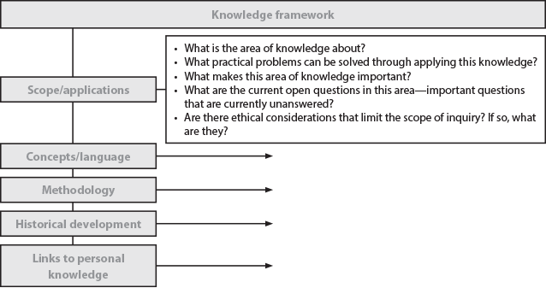
TOK Knowledge Framework

Slide 3
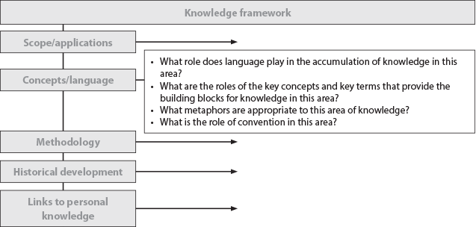
TOK Knowledge Framework

Slide 4
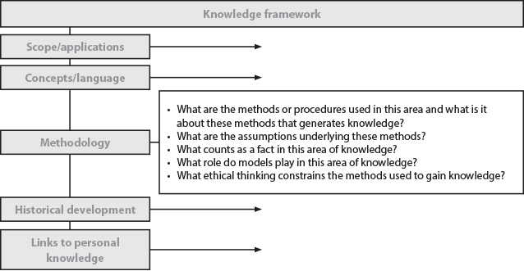
TOK Knowledge Framework

Slide 5
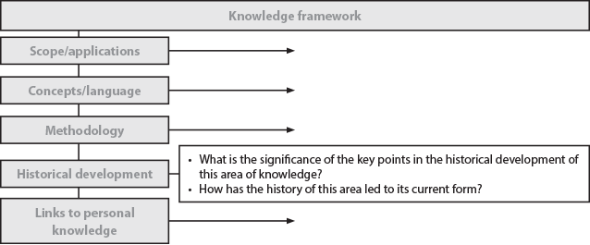
TOK Knowledge Framework

Slide 6
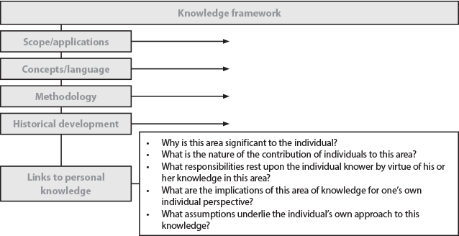
TOK Knowledge Framework

